Slide 1

Global CO2 Emissions Modeling and Analysis via Machine Learning
Presented By:
K Chaitanya Kumar-21J41A66F6
G Snehalatha Reddy-21J41A66E6
P Rakshitha-21J41A66H6
T Karthikeya-21J41A66J7

Slide 2





The Urgency of CO2 Reduction and Modeling
Rising CO2 levels are driving climate change. Accurate modeling is crucial for effective mitigation. Machine learning offers powerful tools for this task. It helps us understand complex emission patterns.
Urgency
CO2 levels are rising rapidly.
Modeling
Crucial for mitigation.
Machine Learning
Offers powerful tools.
Understanding
Helps complex emission patterns.

Slide 3

Data Acquisition and Preprocessing
We built a dataset from global sources. This included energy consumption and industrial output. Data preprocessing involved cleaning and normalization. This ensures data quality and consistency. This is crucial for reliable modeling.
Global Sources
Cleaning
Normalization
Wide range of energy and industrial data.
Handling missing and incorrect values.
Scaling data for consistency.

Slide 4




Feature Engineering
Key predictors were identified using domain expertise. Population density and GDP were strong indicators. Sector-specific data, like transportation emissions, mattered too. Feature selection improved model performance greatly.
Population
GDP
Transportation
Density impacts emissions.
Economic activity matters.
Emissions are key.

Slide 5
Machine Learning Models
We selected regression and time series models. Random forests and ARIMA were tested extensively. Model training involved optimizing parameters. Hyperparameter tuning enhanced predictive accuracy.
Regression Models
Time Series Models
Random Forests for accuracy.
ARIMA for temporal patterns.

Slide 6
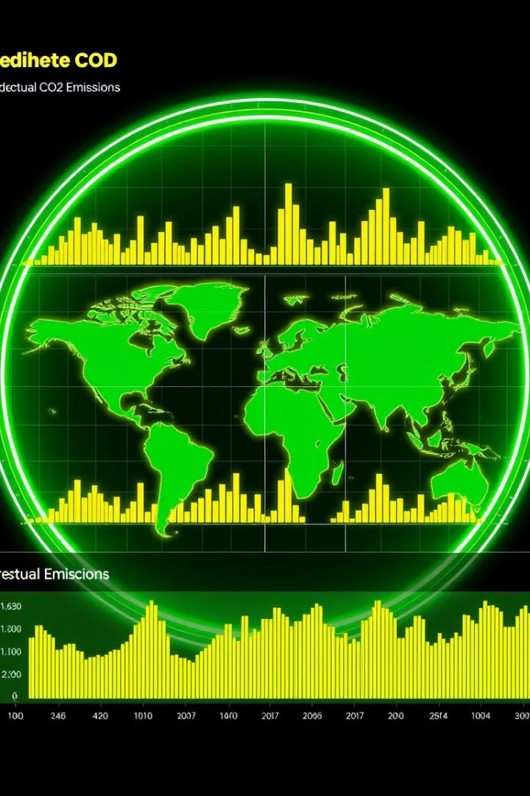
Model Validation and Evaluation
Validation used unseen data to prevent overfitting. Metrics included R-squared and RMSE. The models showed strong predictive power. Accuracy and reliability were carefully assessed.
1
Unseen Data
2
R-squared
Prevented overfitting.
Measured variance.
3
RMSE
Measured error.

Slide 7

Regional Analysis
Emission patterns varied across regions significantly. Developed countries showed higher per capita emissions. Developing countries saw rapid emission growth. Targeted policies can address these disparities.
1
Developed Nations
High emissions per capita.
2
Developing Nations
Rapid emission growth.

Slide 8



Scenario Planning
We predicted future emissions under different scenarios. These included policy changes and technological advancements. Aggressive policies can significantly reduce emissions. This informs strategic climate action planning.
1
Low Policy
2
Medium Policy
3
High Policy

Slide 9


Case Studies
Some cities have successfully reduced emissions via ML. Smart grids and optimized transportation are key. These examples offer valuable lessons. They show the potential of data-driven solutions.
Smart Grids
Transportation
Optimize energy use.
Optimize routes.

Slide 10



Challenges and Future Directions
Data gaps and model complexity remain challenges. Future work involves incorporating climate feedback loops. Enhanced computing power can improve predictions. Collaboration is crucial for global impact.
2
Model Complexity
1
Data Gaps
Climate Feedback
3

Slide 11
THANK YOU

